Slide 1
Joint Council Priority: Identity Management
Roadmap Update
Sophia Howse, Executive Director, Provincial Identity Information Management Program, BC
Jackie Stankey, Acting Executive Director Client Relationship Management, AB

Slide 2

Why does Digital Identity matter?
Digital Identity equips Joint Councils to realize long term goals:
Notes:
Sophia Present

Slide 3

Background
September 2016 – Joint Council agreed to leverage the FPT DMs’ Table to accelerate priority initiatives.
December 2016-Jan 2017 the FWG completed one-on-one consultations with JC membership on JC and jurisdictional priorities.
February 2017 – FWG presented priorities research and analysis at in-person meeting.
April 2017 - Clerks and Cabinet Secretaries requested that identity management be accelerated more quickly.
May 2017 – FPT DMs’ Table Presentation on the Pilot Opportunities Working Group (POWG).
Notes:
Jackie Present

Slide 4

Roadmap Background
February 2017 – Joint Council in-person meeting.
Identity Management was identified as top priority.
Alberta and British Columbia identified as co-leads for Identity Management.
October 2017 – Co-leads developed draft roadmap with input from all jurisdictions through the Identity Management Sub-Committee (IMSC) and the Framework Working Group.
Reviewed by Joint Council October 5, 2017.
Reviewed by FPT DMs
October 12, 2017
December 2017 --Co-leads identified need for federal representation in priority work stream.
Notes:
Jackie Present

Slide 5





Roadmap Components
POLICY AND GOVERNANCE
COMMUNICATION AND COLLABORATION
PAN-CANADIAN TRUST FRAMEWORK
PILOTS
TECHNOLOGY
Notes:
Sophia Present

Slide 6
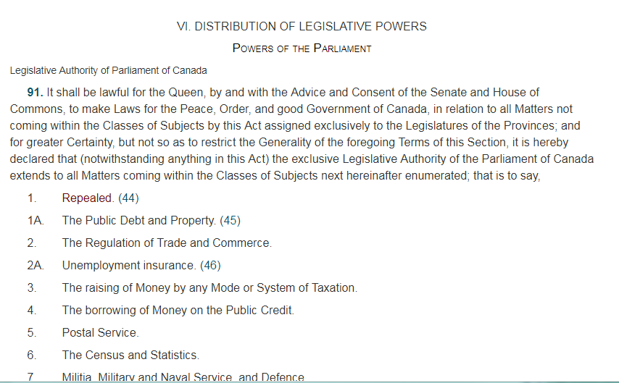
Policy and Governance
Articulating a Pan-Canadian public policy position on Identity Management
Notes:
Sophia Present

Slide 7
Policy and Governance
Notes:
Sophia Present

Slide 8

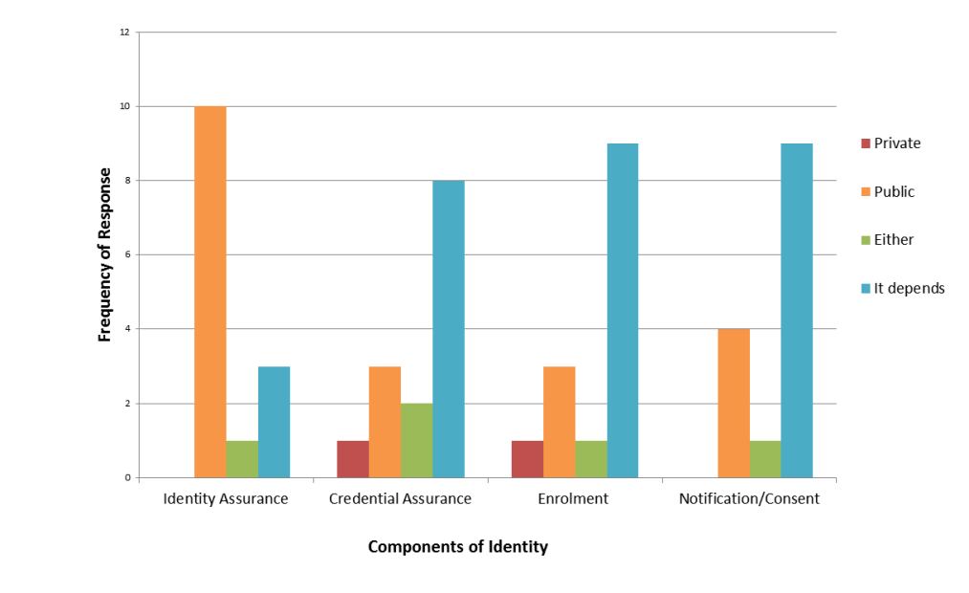

Policy and Governance
The Ask – Endorsement to create a
Public Policy Working Group
}
?
Notes:
Sophia Present

Slide 9


Communication & Collaboration
Evolve from telling what we’ve done
To sharing why it is important and what you get if it’s done well
Notes:
Jackie Present

Slide 10
Communication & Collaboration
The Ask - Proposal to seek funding:
Aligning with other initiatives?
Targeted deliverables:
Identity 101 (basic identity concepts)
Canada’s Identity Story
Impacts of different approaches to identity management
Maintained “Advancing Identity Management Roadmap”
Artifact sharing platform
What have we missed?
Who will champion?
Within what timeline do you expect it to be delivered?
Notes:
Jackie Present

Slide 11

IMSC
Status Update
Notes:
Please confirm who will present these (Marc/Rob?).
Question to Marc/Rob: Do you have any questions for JC that you need direction on to move forward?

Slide 12
Pan-Canadian Trust Framework
Overall Status and Next Steps
IMSC Update
New IMSC Co-Chair – Marc Brouillard, Government of Canada
Existing IMSC Co-Chair – Rob Devries, Government of Ontario
IMSC In-person meeting tentatively planned for spring 2018
Pan-Canadian Trust Framework (PCTF) Component Update
IMSC and DIACC continue to work on PCTF components: Verified Person, Verified Login and Verified Organization
Alpha testing guide for Verified Person is complete
Initial testing with ESDC-My Alberta Digital ID Pilot
Intention to have other jurisdictions carry out Alpha testing
Notes:
Please confirm who will present these (Marc/Rob?).
Question to Marc/Rob: Do you have any questions for JC that you need direction on to move forward?

Slide 13
Pan-Canadian Trust Framework
“Alpha Testing” Conformance Criteria
Verified Person “Alpha Testing” (Winter 2018 – Spring 2018)
Verified Organization “Alpha Testing” (Winter 2018 – Spring 2018)
What does this mean for Business Owners / Program Delivery Managers?
Opportunity to provide concrete feedback
Develop a common understanding of similar processes carried out in different places
Inform the development and practical application of the trust framework (pilots)
Use as feedback for service design/digital transformation initiatives.
Notes:
Please confirm who will present these (Marc/Rob?).
Question to Marc/Rob: Do you have any questions for JC that you need direction on to move forward?

Slide 14
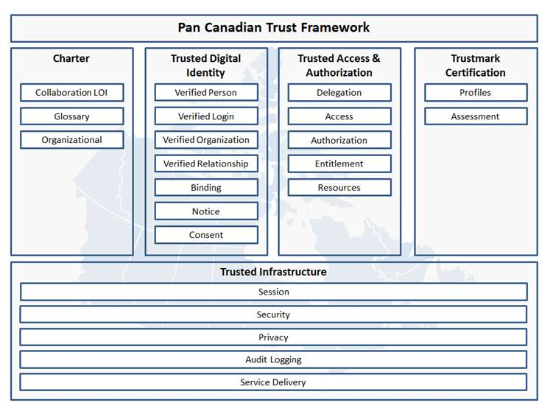
Pan-Canadian Trust Framework
Component Status
Legend
Complete
First Draft
In Draft – IMSC Lead
In Draft –DIACC Lead
Notes:
Please confirm who will present these (Marc/Rob?).
Question to Marc/Rob: Do you have any questions for JC that you need direction on to move forward?

Slide 15





Pilots
4 types
a. Testing inter-jurisdictional governance/policy processes
b. Supporting Client Centric Service Delivery
c. Testing out trust framework / standards
d. Testing existing and emerging technologies
Notes:
Jackie Present

Slide 16

Status Update
Canada’s Digital Interchange (CDI)
Testing inter-jurisdictional governance and policy processes
Notes:
CDI – Rob F. Presents

Slide 17
Pilots: Alberta & MSCA
The MyAlberta Digital ID (MADI) Pilot is jointly-led by ESDC and TBS, in collaboration with the province of Alberta.
The pilot will require federal acceptance of a provincial Trusted Digital Identity (MADI) in accordance with the Pan-Canadian Trust Framework.
Alberta residents using a MADI to register for My Service Canada Account (MSCA) will receive streamlined and fully digital access to ESDC programs (such as Canada Pension Plan and Old Age Security) as well as the Linked Accounts initiative with Canada Revenue Agency (CRA).
ESDC is working with TBS and Alberta to complete the formal assessment of MADI against the PCTF and obtain federal endorsement of MADI.
The pilot is expected to go live in fall 2018.
Notes:
CDI – Rob/Jackie/Chantal

Slide 18
Pilots: Nova Scotia & SIR
Component 1: NS to validate client identity information against the Social Insurance Registry (SIR)
Currently pursuing required authorities and assessing privacy impacts.
Technical build has been initiated.
Component 2: ESDC to validate client identity information against NS’ Vital Statistics Office (VSO) registry
Due to technical challenges (stability of VSO registry), NS is no longer able to participate in pilot component #2.
ESDC is currently seeking a new provincial partner for this component.
Notes:
CDI – Rob/Arlene

Slide 19

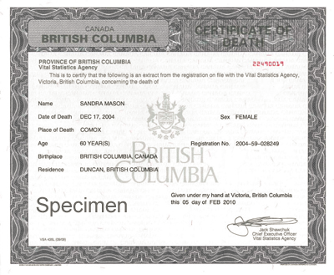
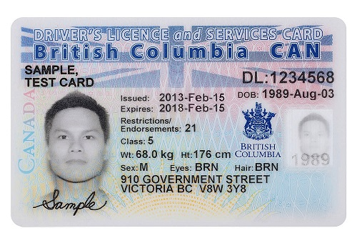
3a. Pilots: Supporting Client Centric Services
Death Notification
Notes:
Sophia Present

Slide 20

3a. Pilots: Supporting Client Centric Services
Student Loans
Notes:
Sophia Present

Slide 21

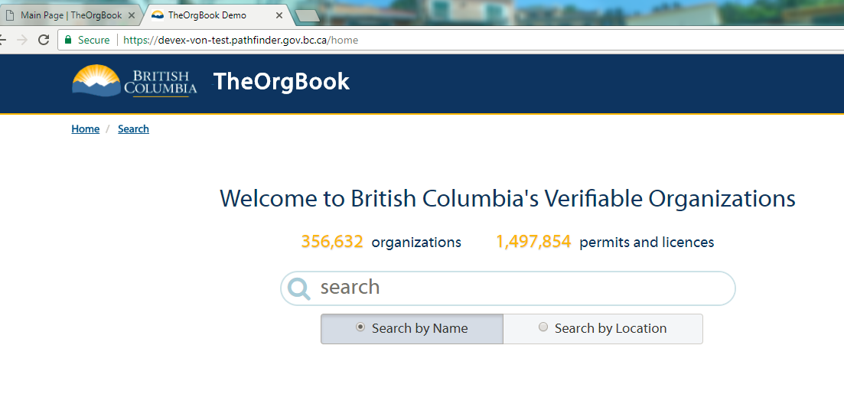
3b. Pilots: Testing out the Trust Framework
Notes:
Sophia/Bev Present

Slide 22
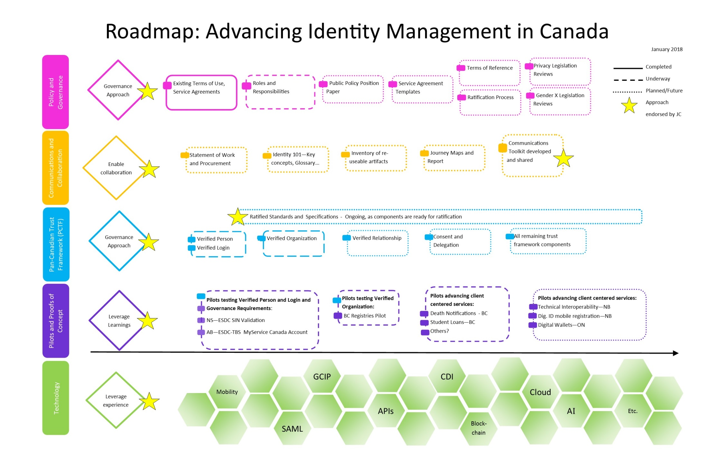
Notes:
Jackie Present

Slide 23
Thank you!

